Slide 1
Introduction to Stage Lights
Module 8 – Design process and script analysis

Slide 2
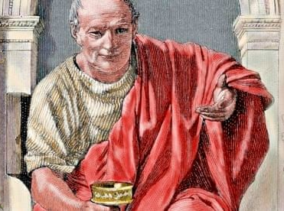
Purpose of theater
The early philosopher Horace wrote in his manuscript Ars Poetica
The object of theater is to delight and instruct
Horace 65 - 8 BC

Slide 3
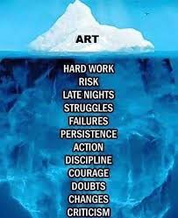
What’s happening “behind the scenes”
Design is a process
There is more than one way to design, unique to each designer
In the process we pursue the goal of creating art
In the case of lighting, we contribute artistic lighting choices

Slide 4
Problem solving model
Commitment
Analysis
Research
Incubation
Selection
Implementation
Evaluation

Slide 5
Commitment
Whether assigned or applied for, commitment is the willingness to commit energy to the production
That you will focus your efforts and attention into your best possible work
Your quality is a reflection of your level of commitment

Slide 6
Analysis
Getting information and find areas that need further research
This goes beyond the text
Asking director or producer
Why are you doing the show
When are you doing the shop
How large of scale and scope is the production
Reading a script cold (gives you an understanding of the story)
Reading a script with context (reading again with the above answers in mind)

Slide 7
Reading a script
Actual text
Message
Theme
Meaning
Subtext
What are the characters doing?
How are the doing it?
What are the consequences of their actions?

Slide 8
Research
The active effort to supplement already known information
Improve on areas of weaker knowledge, experience, and background
Background research – key words provided by text
Informed by time period and location of the production
Look into the background of the author
Conceptual research – comes from design team and internal feeling
Creative search, pulling from others art to inform shape, form and style

Slide 9
Incubation
Time to process and develop
Maturation of ideas
Sometimes you need to step away in order to come back with fresh eyes
Design takes time to develop and cannot be rushed.

Slide 10
Selection
Sifting through the ideas to find an organized design concept
Presenting selected collection to design team
This informs other design members
Discussions with team can lead to a more cohesive design as a whole

Slide 11
Implementation
Fleshing out your ideas
Adding more content while adhering to your concept
Developing a light plot
The lighting fixtures and positions that will be available
Instrument schedule
Information for the master electrician to hang/install lights from
Director and scenic are most informative at this time
Blocking and scenic interference

Slide 12
Evaluation
Taking a step back and looking at your work critically
Regularly we are so close to our work that we can’t tell if we are going int the right direction
“can’t see the forest through the trees”
Asking for external input
Feedback from fellow designers or other members of design team
This happens through out the production process and once more once the production has concluded
Post-mortem or Response & Review

Slide 13
3 read approach – Script analysis
First read - reading for content/fun
Who are the characters and what literally happens
Ignore stage directions
Second read
Write down descriptors
Let your imagination wander and document where it went
Third read
Write down specifics that are mentioned in script
Time of day, season, location, practicals, effects
If the script says it, it should not be ignored
Motivated light cues (end of scene needs a blackout)

Slide 14
Practical design approach
Reading the script should generate some inspiration
Feeling, mood, flavor, etc. (both physical and emotional)
These feelings need to be jotted down and likely shared with the director
Feeling, mood, and flavor will change over time
Changes happen, location, time of year, time of day
Every different moment is a change
This could happen at the scene change or various times within a scene
You as a designer want all inspiration to be represented
Your textbook calls this the ”Image of Light”

Slide 15
Practical design approach cont.
Eventually you as a designer must visually conceptualize inspiration
Words are the the starting place → move to visuals
Everyone interprets words differently
Images are very useful
Pictures showcasing feeling, mood, flavor allow other designers and director to relate
From these pictures we can extract color, texture, and angle/sharpness of light
This information informs our creation of a lighting key

Slide 16
Key and Fill light definitions
Key lights are the brightest in a scene
Fill lights are dimmer and used to lessen shadows

Slide 17
Extract descriptors from these pictures

Slide 18
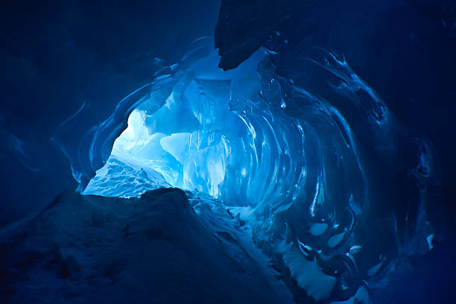
Extract descriptors from these pictures

Slide 19
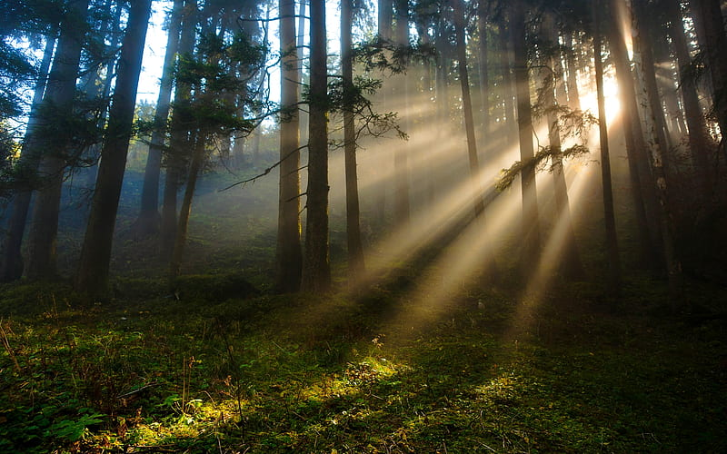
Extract descriptors from these pictures

Slide 20
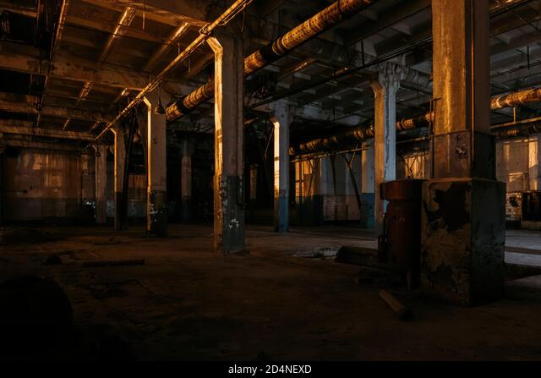
Extract descriptors from these pictures

Slide 21
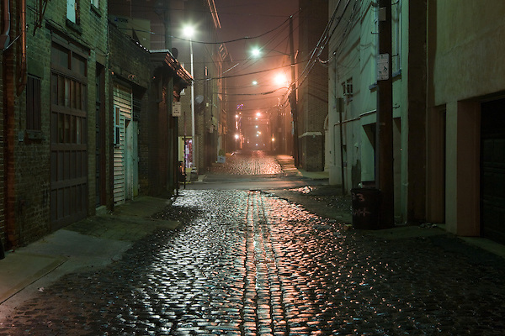
Extract descriptors from these pictures

Slide 22
Extract descriptors from these pictures

Slide 23
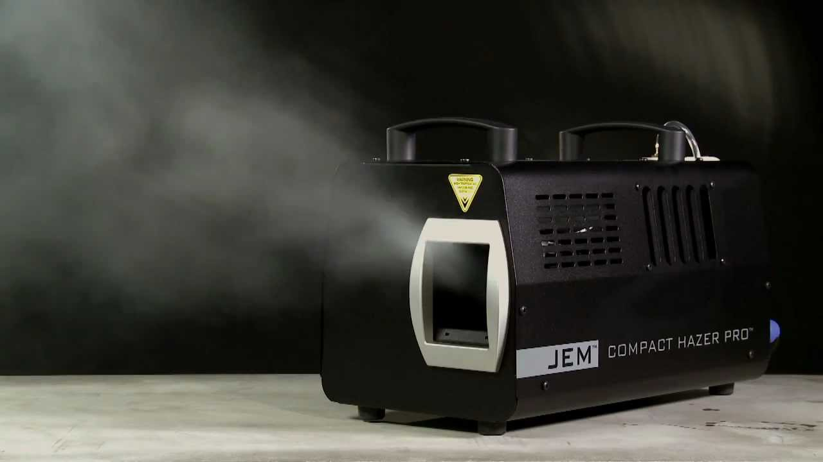
Imagery can inform our design concept
Diffusion

Slide 24
Lighting Key
Fill
Key
Fill
Fill
N/C
Fill

Slide 25
How we pick exact color
Gel swatch book
Color picker on lightboard

