Slide 1
Introduction to Stage Lights
Module 7 – projections

Slide 2
Who’s responsible for projections?
Projections are generated from light sources
Because of this they can be the responsibility of the lighting dept.
They can also be their own department
Such is the case on large shows (Broadway/touring)
”video” and “Lights” have to work closely together
Stage lights can wash out projections and visa versa

Slide 3
Film based projections
Uses large slides for still projections
Big bright light source that projects an image through a lens
More than one can be used to “crossfade” between images
Required an operator to douse the light and to change slides

Slide 4
Why not use a film reel like traditional movies

Slide 5
Digital projections
Will project any content that is connected to it via cable
Still images, slide shows, animation, video, ect.
Require an operator on playing device for cueing
Overcoming low brightness →

Slide 6
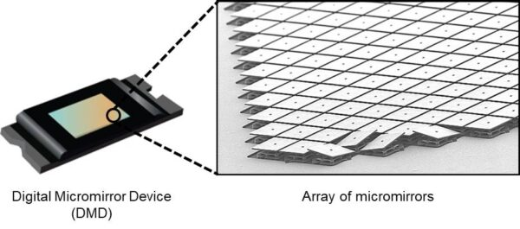
Different digital projector technology
Liquid crystal display (LCD)
Uses a mirror per color to split image, then 3 colors converge on a combiner before exiting the lens
Digital light processor (DLP)
Uses “micromirrors” to reflect light at the pixel level
LED
Uses an LED light source (similar to LCD)
Laser
Uses 3 colored lasers as light sources

Slide 7
Problem with black
Because we can’t project “black color”
Digital black is a dark purple-ish
Use a dowser if you want a total blackout

Slide 8
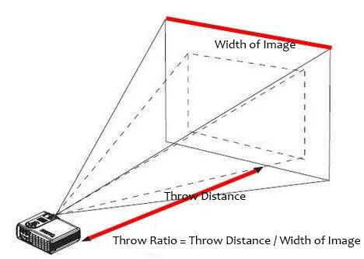
Concept of throw distance
Projectors of any sort have limitations
Projections aren’t as bright under two conditions
The bigger the image from same distance
The further back you get from the surface receiving the projection

Slide 9
Why projections so popular?
Faster to make than a painted backdrop
Cheaper to make than building elaborate physical scenery
This excludes the cost of the computer/projector/software
Can be animated

Slide 10
Projection designers
Projection designers are often their own specialty
Familiarity with projection surfaces, hardware applications and software fluency

Slide 11
Qlab – Cue based

Slide 12
Isadora – object oriented programing

Slide 13
Front vs rear projection
Front Projection
Rear projection
Any surface “could” be projected on
Don’t need space behind set to position projector
Shadows
Exaggerated projection angles
No shadows on screen
Requires a specially designed material to project on
Otherwise a hotspot is seen
Requires space behind set for projector to be positioned
Can eliminate a crossover location

