Slide 1
Introduction to Stage Lights
Module 6 – Color theory

Slide 2
Hue
Hue is the name of the color
Red
Orange
Yellow
Green
Blue
Violet

Slide 3
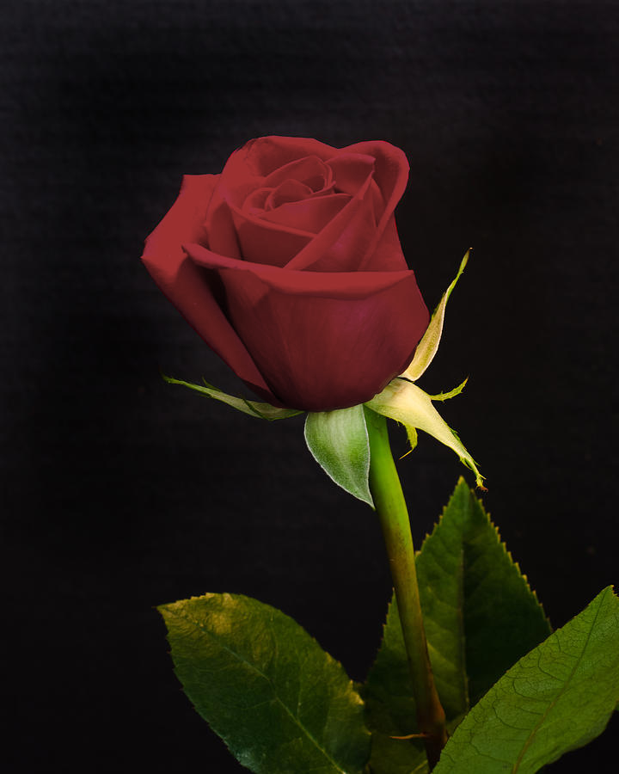
Saturation
Saturation is how strong of a color is presented

Slide 4
Value
Value is the brightness or darkness of a color
This term is relative and used to compare different colors
The brighter the color, the higher the value

Slide 5
Tint
Tint is a color created from adding white to a hue

Slide 6
Shade
Shade is adding black to a hue

Slide 7
Tone
Tone is created by mixing a hue with grey

Slide 8
Warm and cool colors

Slide 9
How we “see” color
Every color we see is reflected
The color we see is what’s not absorbed, what’s reflected

Slide 10
Color Light Pigment

Slide 11
Additive vs subtractive
Additive color (light)
When more colors are added the new color gets closer to white
Black is the absence of color
Subtractive color (pigment)
When more colors are added the new color gets closer to black
White is the absence of color

Slide 12
Subtractive color in light

Slide 13
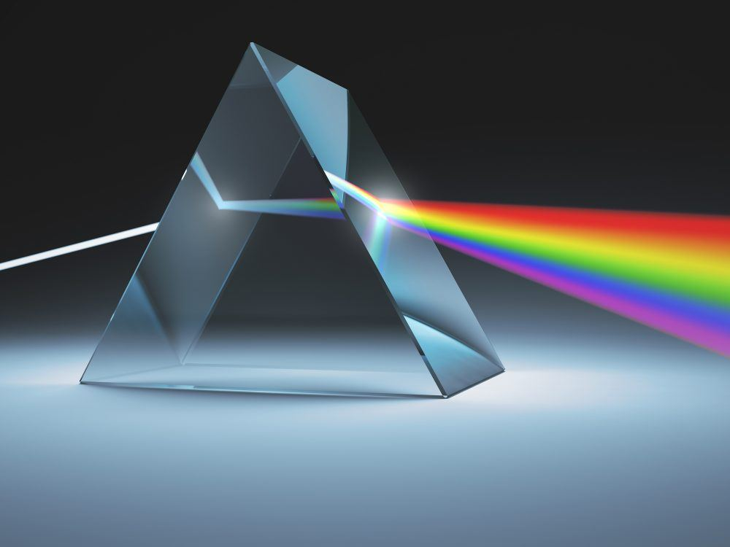
What is a full spectrum light
Full spectrum means all colors of light are leaving the fixture
If all colors are represented, the color of light would appear white
LED fixtures have different colored diodes inside in order to represent the majority of the spectrum
This is why white LED house lights are bad for growing plants
We can subtract color in light by using gel filters
Gel prevents certain colors from passing through, changing the appearance of light

Slide 14
Color of set and costume influence the color choices of the lighting designer

Slide 15
Light positions
In theater we hang lights at various positions in order to not only light the scene but to create mood and to simulate time of day

Slide 16
Front light
Front light easily illuminates, and doesn’t create much shadow on figure (exception under chin)
Rather flattening, features don’t “pop”

Slide 17
Angled front light
Illuminates the majority of the figure, cleans up some shadow under chin, leaves 1/3 of face dark
Features begin to stand out
Has a “dramatic feel”
SR Front →

Slide 18
Side light
Used to make features most defined
½ face in shadow
When paired with a complimenting light on opposite side, created small shadow line down middle of face
Very useful for dance

Slide 19
Top light
Used to glow crown of head and shoulders
When used with a saturated hue of light, creates an interesting effect

Slide 20
Front Uplight
More of an effect light
Eliminates under chin shadow
Also lights under wide rimmed hats
Reminiscent of foot lights from old theaters
Also the “scary ghost story” look

Slide 21
Silhouette
Another effect lighting position
Created by only using cyc lights
Frequently used in dace

Slide 22
A lighting key explained
A lighting key is a pictorial reference of fixtures for any one common area on the stage
Consists of all fixtures with angles and gel colors (and gobos) defined
One of the pieces of paperwork generated by a lighting designer

Slide 23
Complimentary color concept
Complimentary colors are a primary and the opposite secondary color on the color wheel
When complimentary colors are mixed, in light we see white light
We also see colored shadows

Slide 24
Colored shadows
What direction are the red and blue light coming from?

Slide 25
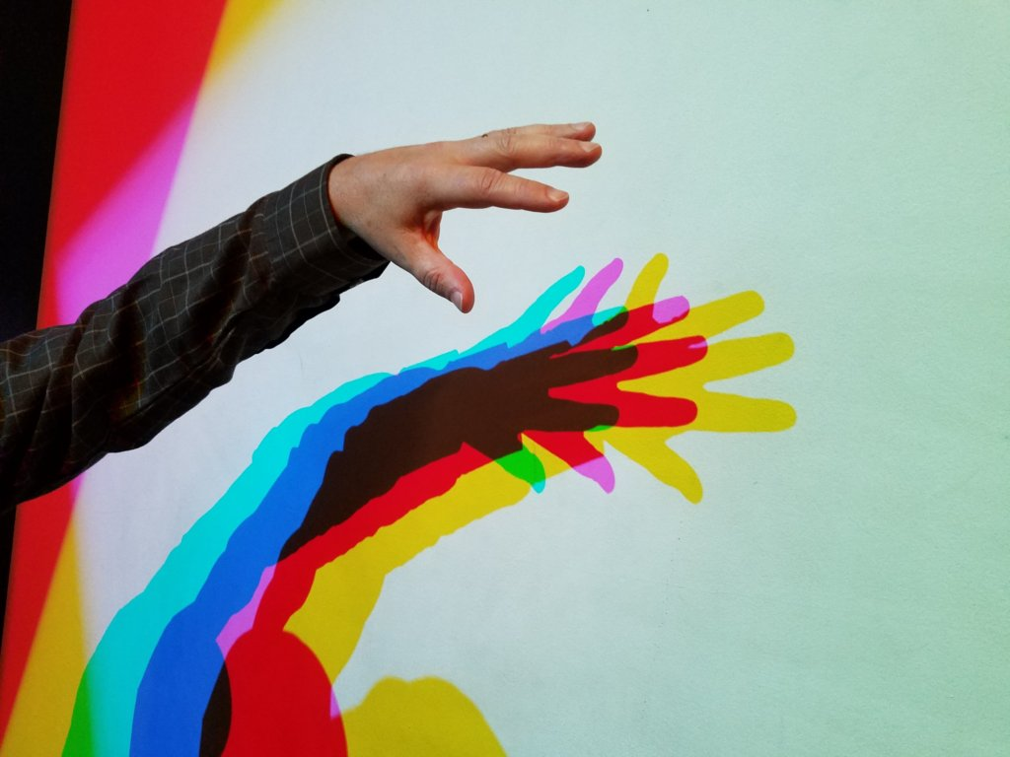

Slide 26
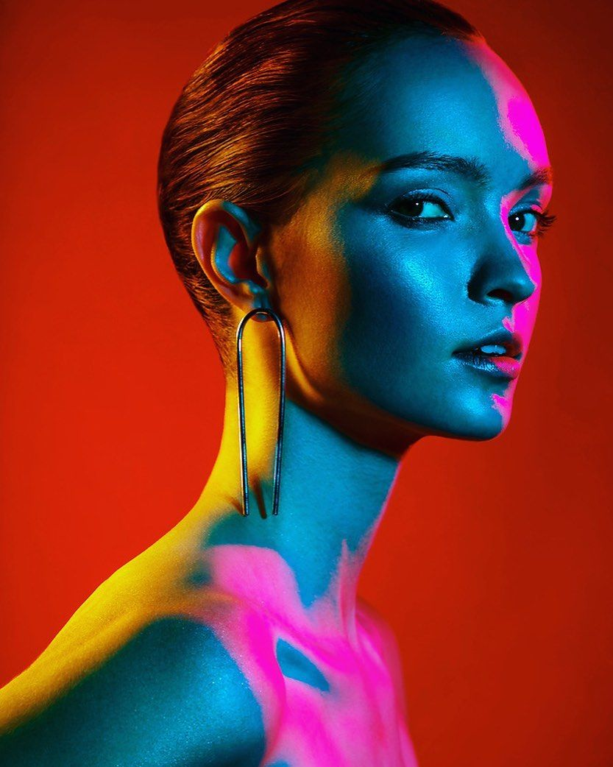
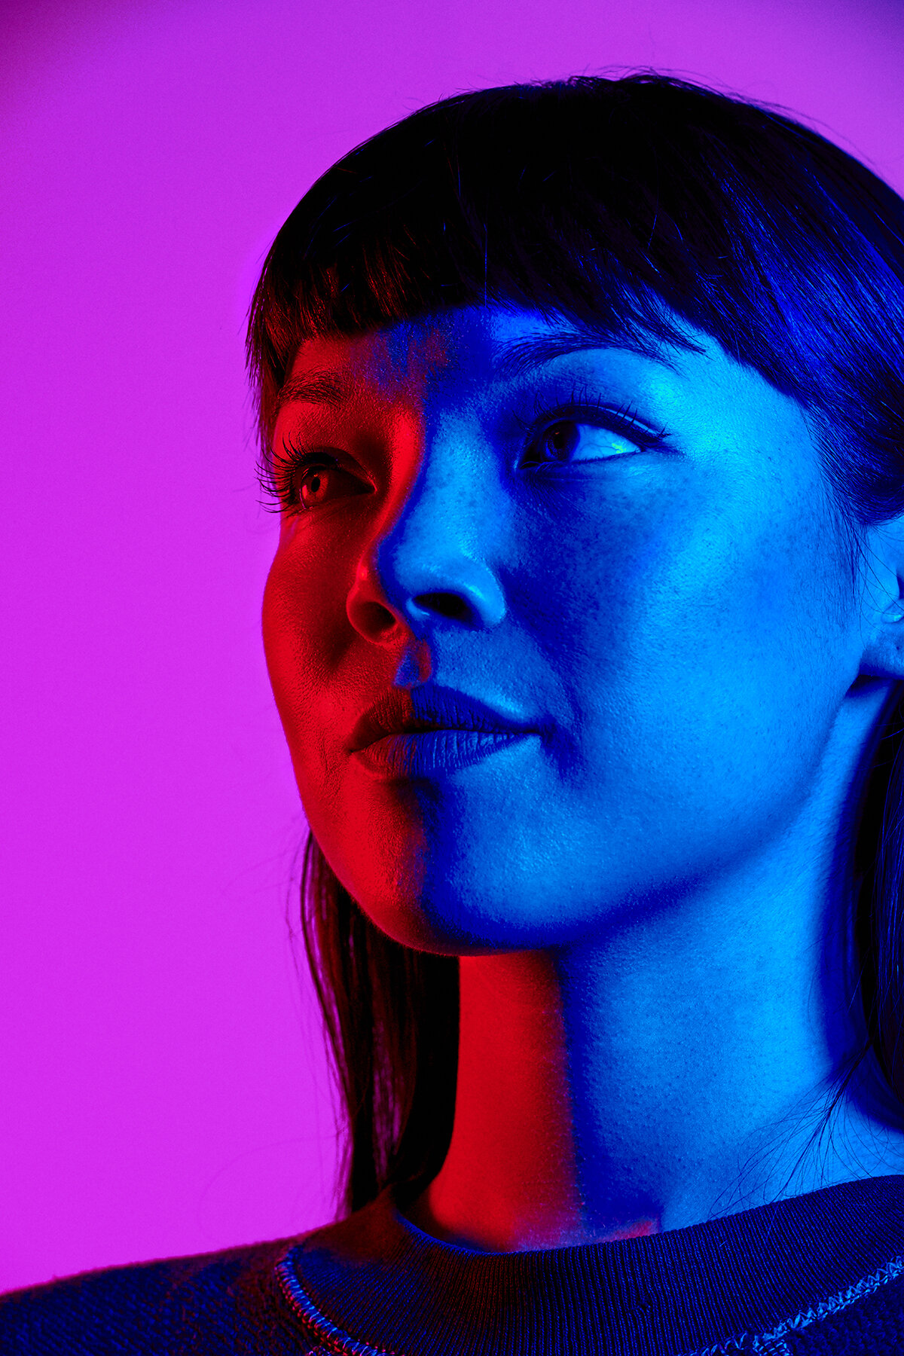
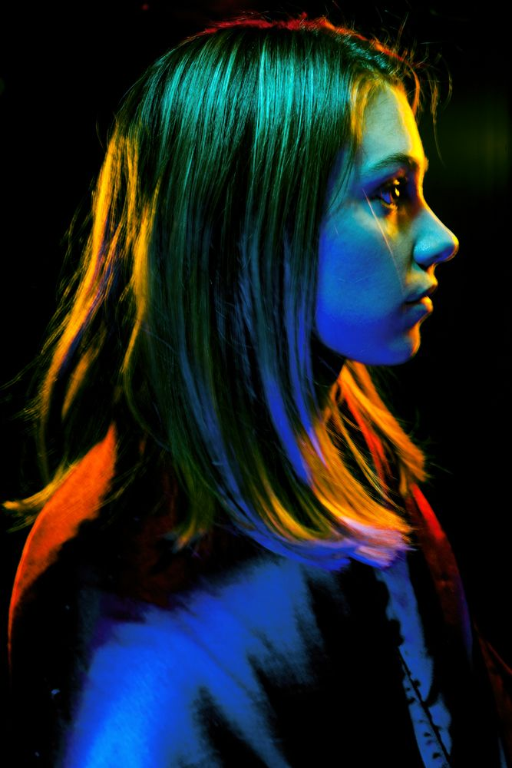
Bold color directional light for effect

