Slide 1
Introduction to Stage Lights
Module 5 – Practicles and effects

Slide 2
What is a practical?
Any working light source on stage
Floor lamps
Chandeliers
Wall sconces
Torches
In every case the appearance of the practical is relevant to the play
Why, because these objects are seen
Unlike stage lighting which is often hidden or masked

Slide 3
Handheld lighting instruments
Aren’t objects an actor holds considered a prop – Yes
Depending on the structure of an organization
The Props dept will take care of it
The props dept will design and build the object, Lighting must electrify it
The lighting dept will build and electrify it from designer’s reference image

Slide 4
Purpose of practicals
Designed to look intentional and enhance the scene
Not look fake, cheesy, or distract
Not intended to illuminate the stage
We have stage lighting for that
DO want to give the illusion that they are the scenes light source
Regularly use lower wattage lamps or run them less than full

Slide 5
Fire
We do everything we can to prevent fire on stage
This is why we fireproof curtains and treat scenery with fire retardant
This is also why you see all raw wood painted over on Broadway touring sets
In many theaters it is 100% not allowed, nonnegotiable
In other theaters certain flame elements are allowed
This is determined by fire code and the fire marshal
If fire is going to be used, there is a stagehand in the wing holding an extinguisher

Slide 6
Faking fire
If I can’t have fire, what am I to do?
Fire effects come in different shapes and sizes
Depending on the need of your production, a safe alternative WILL exist

Slide 7
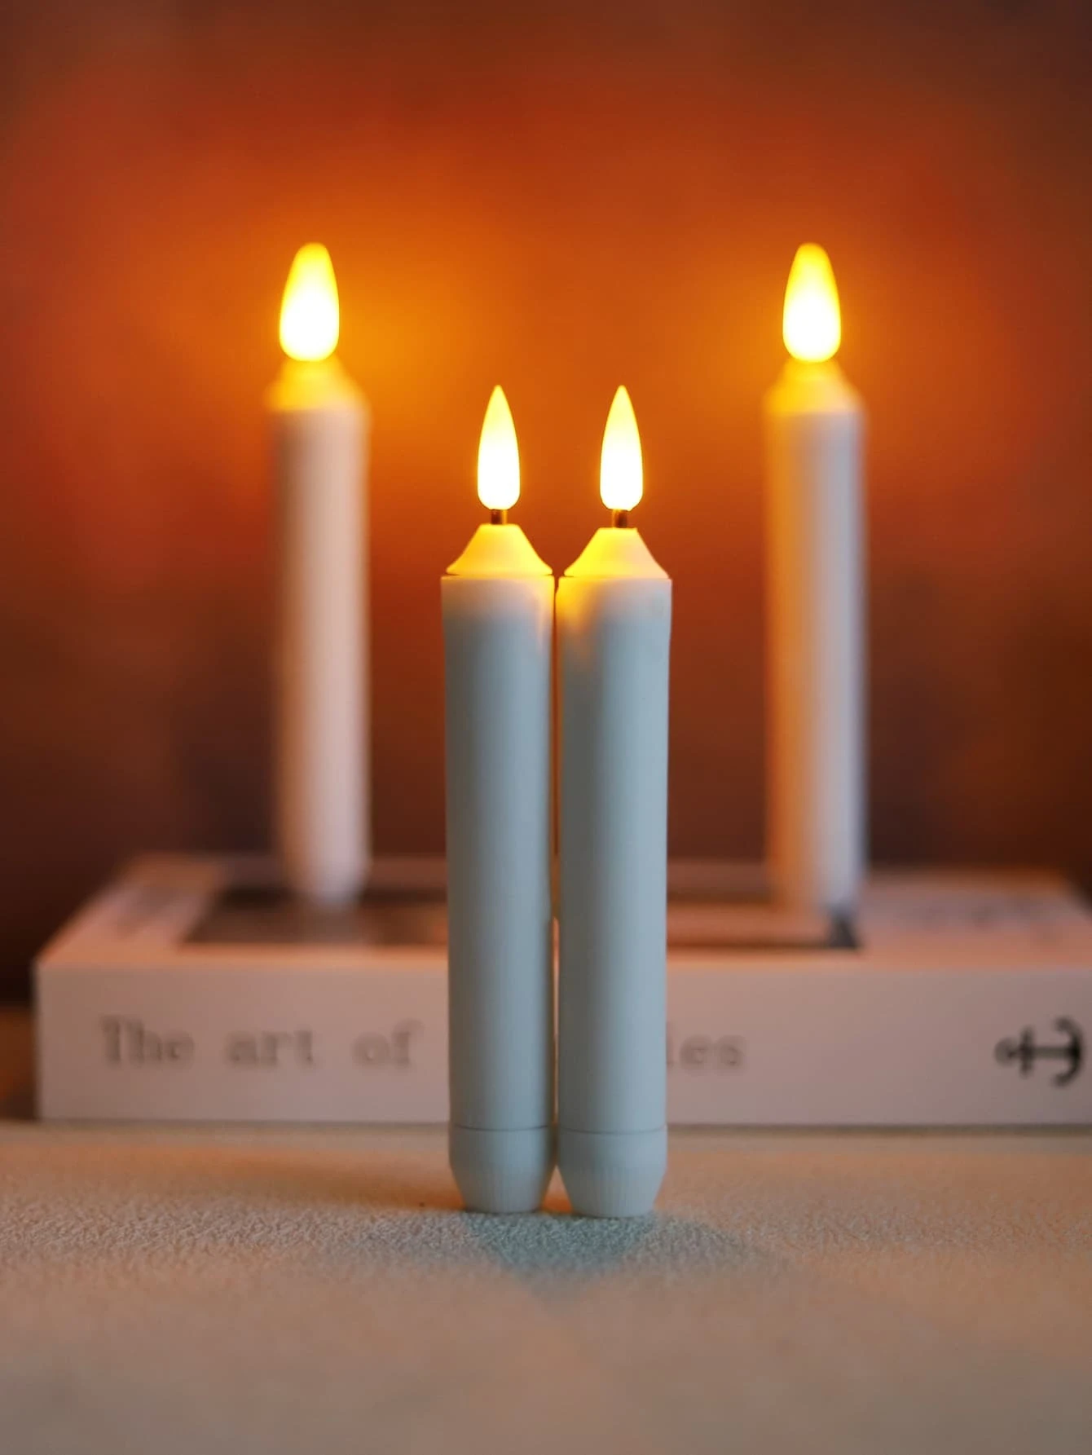
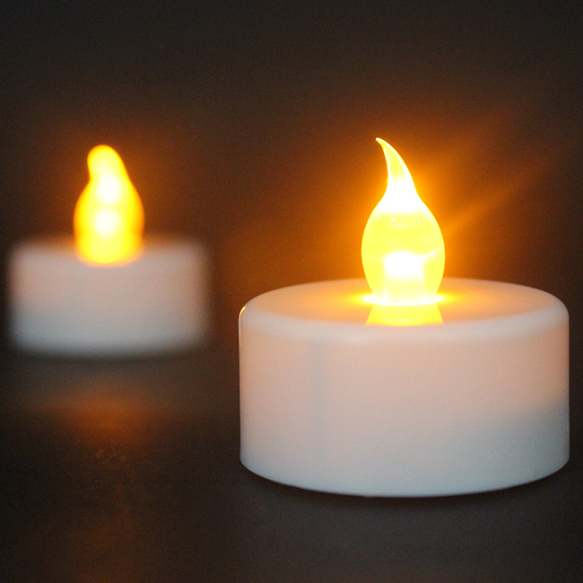
How do you fake fire
In the case of a candle, battery operated options are available
Available in tea light, stick and piler formats
Most have a believable color and flicker effect
Some even respond to movement and wind
What if it doesn’t fit inside my object?
Not uncommon to disassemble to fit inside props

Slide 8
How do you fake fire continued
What if I am trying to make a gas lamp?
Often easier if fixed on stage
Can be corded – no batteries
Used to have to build a flicker circuit
Now we have fire effect lights
Use distress and wear to your advantage
Soot and dirtied panes obscure view

Slide 9
How do you fake fire continued
What about a fireplace
Those exist too, with or without sound
Fire inserts are incredibly believable
Sometimes you can even hide a tv with a fire video playing for maximum realization

Slide 10
How do you fake fire continued
What if I need a lot of fire?
Iridescent silk,, fan and orange light
Best example I’ve seen is Pirates of Caribbean ride

Slide 11
Other effect lights
Moon box
Thin box using indirect light
Hung behind scrim or cyc

Slide 12
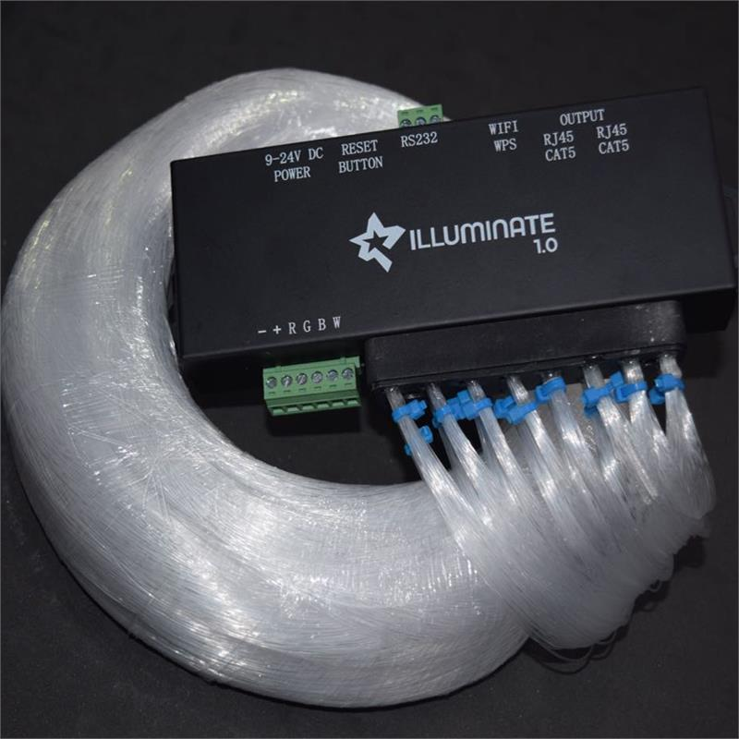
Stars
Often made from curtains and fiberoptic filaments
These can also be rented

Slide 13
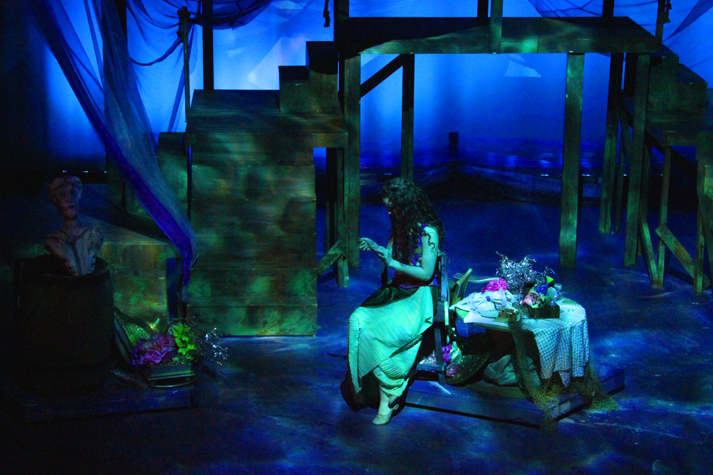
Water
Caustics or ripples
Originally made with a cookie sheet, mirror, fan and light
Can also be made with gobo rotators

Slide 14
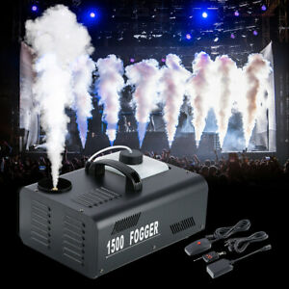
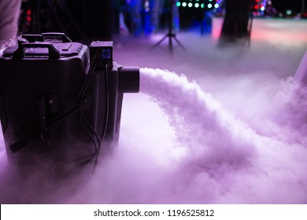
Fog and haze effects
These regularly fall into lighting
Haze is light particles floating in air
Fog has 2 varieties
Burst like smoke
Low lying fog
Some devices have built in lights

