Slide 1
Introduction to Stage Lights
Module 4 – Dimmers

Slide 2
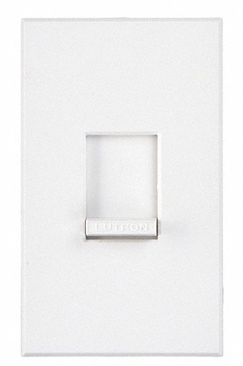
Finding dimmers in everyday life
Many of us use dimmers every day.
Rotary and linear dimmers ->

Slide 3
Concept of a dimmer (early designs)
By varying the voltage, you could vary the output of a lamp
Voltage was “divided” and sent to either the lamp or converted into heat
At full, 100% voltage to lamp
At 50%, 50% voltage to lamp and 50% converted to heat (resistance)

Slide 4
First type of dimmer used salt water?
It worked by lowering an electrode into a salt water container, the more submerged/closer the electrode to the other electrode, the more voltage to the lamp
THESE ARE DANGEROUS!
Electricity and water = bad combo

Slide 5
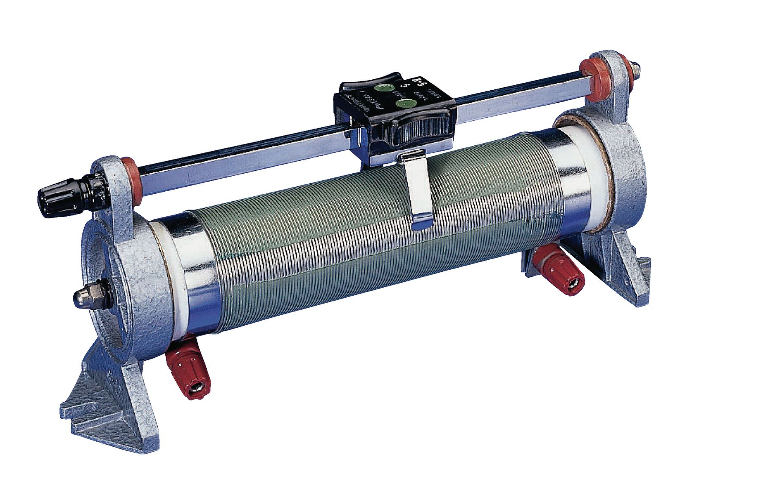
Rheostat
Varies the amount of resistance by increasing or decreasing the length the voltage has to travel
Both rotary and linear rheostats have a wiper that makes contact along a coil at different points.

Slide 6
Autotransformer
Is a rheostat attached to a control motor
A 3-way control switch will trigger a motor to slowly turn in one direction or another increasing or decreasing the resistance (and light output)

Slide 7
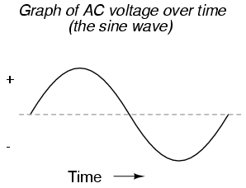
Modern dimmers
Silicon-controlled rectified dimmers
No moving parts
Use gating principle to adjust dimming

Slide 8
Does every light need a dimmer?
Every conventional fixture that needs independent control needs its own dimmer

Slide 9
Controlling dimmers
Originally manual interaction with each dimmer
By pulling levers or rotating knobs
1 lever/knob per dimmer (pg. 107)
Often needed multiple operators
Dimmer s physically located in board

Slide 10
Analog control
Eventually dimmer racks were remotely located to be more strategically placed in the theater
A control system needed to be invented to “talk” to the remote dimmers
Low voltage was used to control each dimmer

Slide 11
0-10V control ( around 1980’s)
Each dimmer had a voltage wire that connected to light board
Shared a common ground
When you slid up a fader, that dimmer’s voltage wire would change
2 different designs
0v = 0 intensity
0v = full intensity

Slide 12
Advanced features for analog boards
Grand master control
2 scene w/ crossfade
Bump buttons
Memory recall

Slide 13
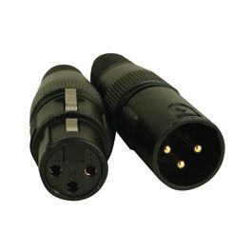
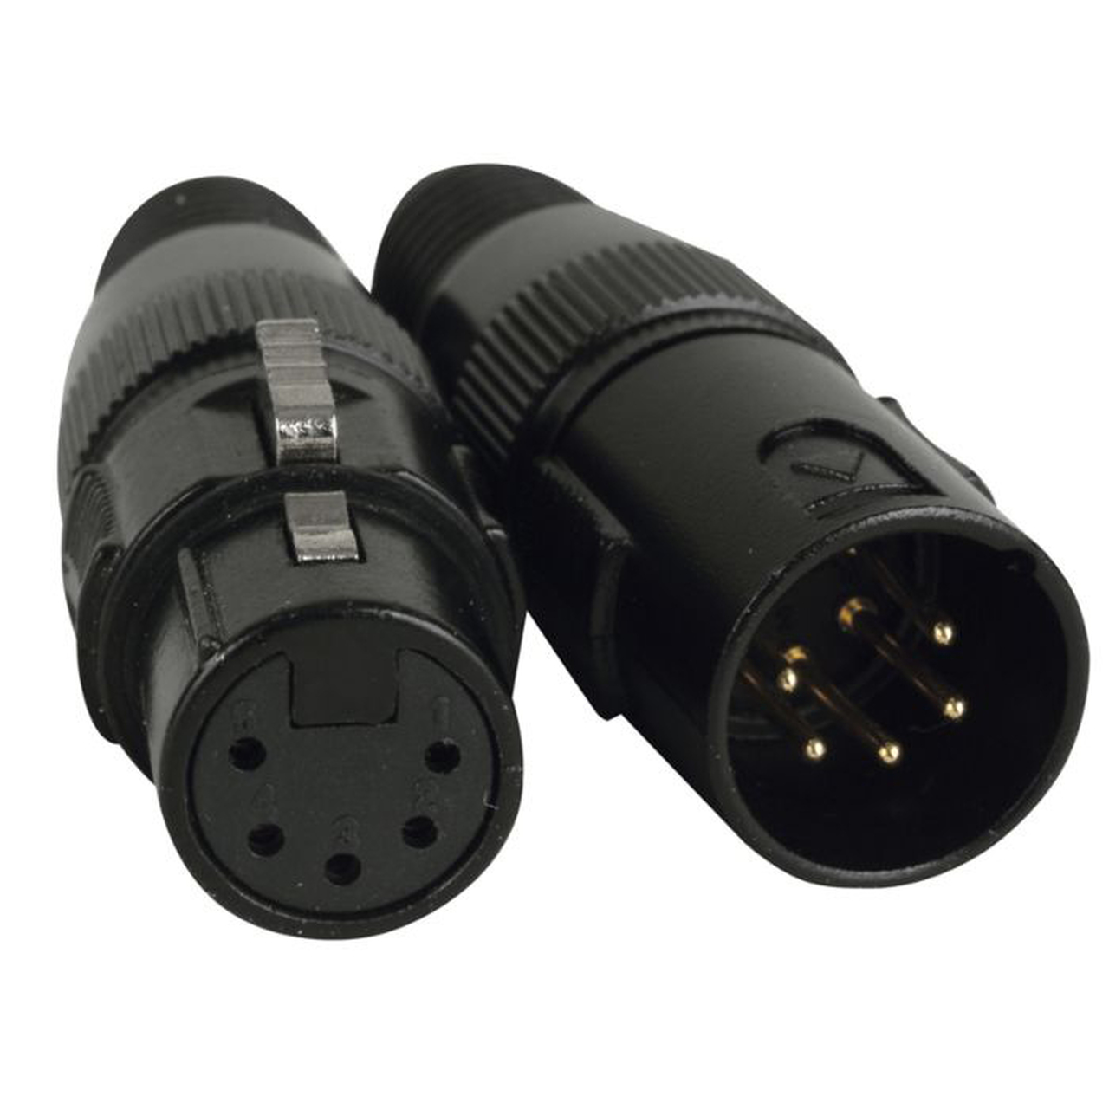
Modern dimming control
DMX = Digital Multiplex
“Talks” via serial computer language
No voltage in the communication cables
One cable can support up to 512 dimmers/fixtures

Slide 14
Concept of addressing
With DMX communications, a dimmer/fixture needs to differentiate itself from its neighbor
Just like house addresses, each dimmer/fixture has a unique address for independent control
if you need more than 512 addresses, you’ll need additional universes
A universe is like a street name and an address is like a house number

Slide 15
Advanced features of digital boards
Timed dimming
Programmable effects
Graphical interface
Some have touchscreens
Additional interface wings
Additional monitors
Channeling (numerical labeling for designers)
Multiple universes 16+

Slide 16
