Slide 1
Introduction to Stage Lights
Module 3 – Cables and connectors

Slide 2
Types of conductors
Solid
Stranded

Slide 3
Solid wire
Single wire core
Jacketed
Used for permanent installation

Slide 4
Stranded wire
Multi-strand core
Jacketed
Used in both permanent and temporary installations
The more strands and thinner each strand, the more flexible the cable is

Slide 5
Wire gauge
Gauge abbreviated as AWG (American Wire Gauge)
As the cross section of a conductor gets larger, the gauge number gets smaller
Ex. a 12awg wire’s conductor is thicker than a 18awg
More than one conductor can be in a wire
Denoted as 12/3 or 16/2 (gauge size conductor / number or conductors)
Individual conductors need to be insulated from each other
Use plastic or rubber typically with an outer jacket to encase them all

Slide 7
Color conventions in power cable
Hot – Black
Neutral – White
Ground – Green
“Black to brass, White to bright, green to ground”
Never assume homemade cables follow this and correct when possible

Slide 8
Twistlock connector
3 conductor
Locks in place using a small twist once pushed all the way in

Slide 9
Stage pin connector
3 conductor
No locking function
Has to be taped
Lose connections require a pin splitter
Green center, closer pin to center is white, black is further
Also caller 2-pin and ground (2P&G)

Slide 10
Edison connector
3 conductor
No locking function
Used on consumer devices

Slide 11
PowerCon connector
3 conductor
Locking function
Push in all the way and twist
A button prevents untwisting

Slide 12
True1 (TrueOne)
3 conductor
Locking function
Push in all the way and twist
A button prevents untwisting

Slide 13
2fer (with stage pin connectors)
A “Y” adapter to provide power to 2 conventional fixtures
Both fixtures will operate together
No independent control
Yes, 3fers exist, but uncommon
Due to ease of overloading

Slide 14
Multi-cable (Socapex)
Comes is various lengths
6 circuits worth
Locking function by screw collar

Slide 15
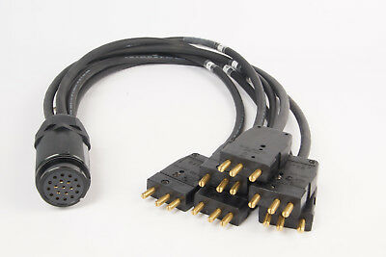
Fan in’s and fan outs
A way to break out individual circuits in multicable
May have any type of connector on ends and don’t have to be the same

Slide 16
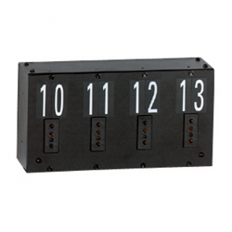
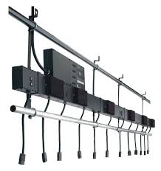
Floor pockets, wall pockets, and raceways
Different locations to find circuits in theaters
Floor pockets are in the floor typically underneath a false door
Wall pockets are more exposed
Raceways are attached to battens

