Slide 1
Introduction to Stage Lights
Module 2 – Lenses, Lamps, Reflectors, and Instruments

Slide 2
Lenses
Lenses are used to bend light
Depending on the shape of the lens, we can spread or compress the light rays
Sometimes it takes more than one lens to achieve correct shape
The use of multiple lenses in combination are called a lens train

Slide 3
Light in air versus in glass
Light traveling through air will not be disrupted
The angle from the source of light does not change
When glass is placed in between, the light rays are altered
Within the glass, an exaggerated angle of bend takes place
The specific amount bend is how instrument manufactures control beam angles

Slide 4
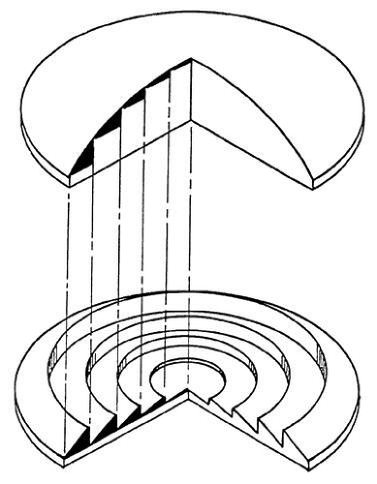
Lens types
Plano-convex lens
A “D” shape, with one flat side and convex side
Bi-convex lens
A lens with both convex sides, appears to be bulging “( )”
Convex-concave lens
Has one convex and one concave side
Fresnel lens
A modified plano-convex lens redesigned to reduce
lens thickness

Slide 5
What is a conventional?
A conventional fixture is one that uses a Tungsten-halogen lamp
These have been around for a long time
Known to get hot

Slide 6
Incandescent
lamp

Slide 7
Tungsten-halogen
lamp

Slide 8
Lamp life
The lamp life is NOT when the amount of time until the lamp burns out, but the amount of time until the light being emitted is only 60%
Most conventional lamps have a lifespan < 2,000 hours
Right before a lamp blows, it often will appear brighter,
why do you think that is?

Slide 9
Arc source lamps
Light generated is from a electrical arc jumping between 2 electrodes
In the same way that light is emitted from a welder
Regularly very blue-white in color
Frequently found in projectors
NOT Dimmable
Needs a physical shutter or dowser
Often have a warm-up period and can’t be immediately turned back on

Slide 10
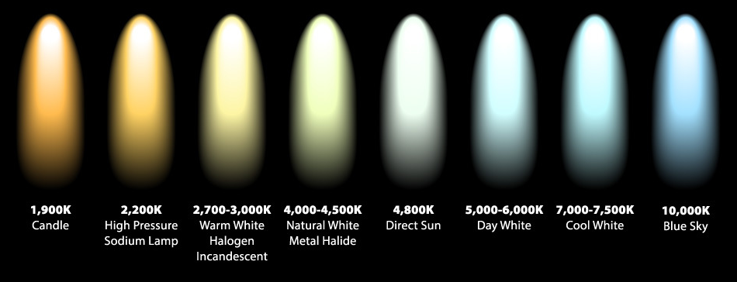
Color temperature
In terms of white light, we can have warm and cool tones
Measured in kelvin which is a unit of temperature

Slide 11
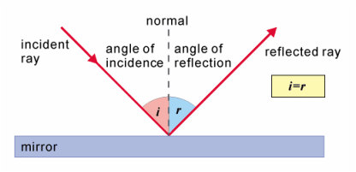
Reflectors
Light reflects in the equal but opposite direction when on a flat surface

Slide 12
Reflectors continued
For a long time, reflector technology is what advanced the output of theatrical lighting fixtures
Made of metal or glass due to heat resistance
Spherical reflector
Parabolic reflector
Ellipsoidal reflector
Combination reflectors

Slide 13
Spotlight vs Wash light
Spotlights (also called profile lights)
Often smaller coverage of stage per instrument
Usually has a sharper focus (hard edges)
often uses less bold colors or N/C
Wash lights
Wider coverage per instrument
Soft edges that overlap other lights of same purpose
Often used for general illumination (in a theater setting)

Slide 14
Lighting Instruments

Slide 15
Concept: Field angle vs Beam angle
Beam angle
Field angle
Area of light that diminished by up to 50% from brightest point
Can appear to be a hotspot
Less even field of light
Area of light that diminished by up to 90% from brightest point
This is most of the lighting cone
This excludes spill
Beam angle is always smaller or equal to field angle

Slide 17
Ellipsoidal Reflector Spotlight (ERS)
Narrow cone of light
Usually a hard(er) edged light
Controllable shape via shutters
Adjustable focus via lens system
Very concentrated with little spill
Measured in Field angle degrees
Common 19°, 26°, 36° and 50°
Ellipse shaped reflector

Slide 18
Beam/Field angles for ETC Source Four ERS
Degree Beam angle Field angle ~Max effective range
5° 6 ° 7 ° 160’
10° 8 ° 11 ° 125’
19° 15 ° 18 ° 70’
26° 18 ° 25 ° 59’
36° 27 ° 36 ° 47’
50° 36 ° 50 ° 31’
70° 60 ° 70 ° 22’
90° 79 ° 87 ° 15’

Slide 19
Concept: flat and peak field of light
Flat
Peak

Slide 20
Fresnel light
Ability to adjust hard and soft edge of light
lamp and reflector slide relative to lens
Done by a crank on back of fixture
Further away, narrower beam
Spherical shaped reflector

Slide 21
Fresnel spot and flood
Spot
Flood (may be a bit larger is size at same distance)

Slide 22
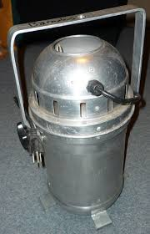
Par can
Minimal adjustment
rotation
Beam angle adjusted by swapping lamps

Slide 23
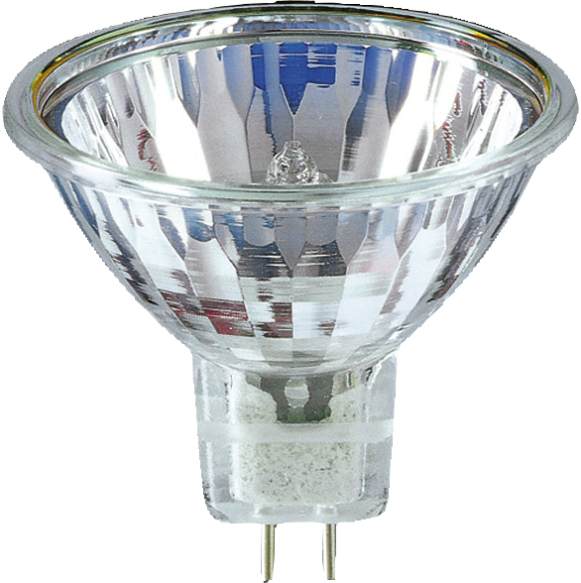
Strip lights
Unique shape - wide and shallow
Multi circuit
Often 3 or 4 circuits per unit
Used for color mixing
Good for uplighting cyc
Called a ground row
Also can be an effect light

Slide 24
Cyc lights
Unique reflector shape "J”
Shapes light to maximize vertical beam
Powerful lamps
Usually 1,000 watts each
3 and 4 circuit units available
1x4 and 2x2

Slide 25
Cyc and ground row combined

Slide 26
Follow Spotlights
Manually operated lights
Mounted on a gimbal
Balanced to move freely
Features
Manual shutter
Iris
Focus
Color/diffusion
Often use an arc lamp – no fade

Slide 27
Booms and Ladders
Boom (aka Tree)
Ladder

Slide 28
Lighting accessories
The following will be a list of more common accessories used in theater

Slide 29
Gel and gobo’s
Gel and diffusion
Gobo (short for go between)

Slide 30
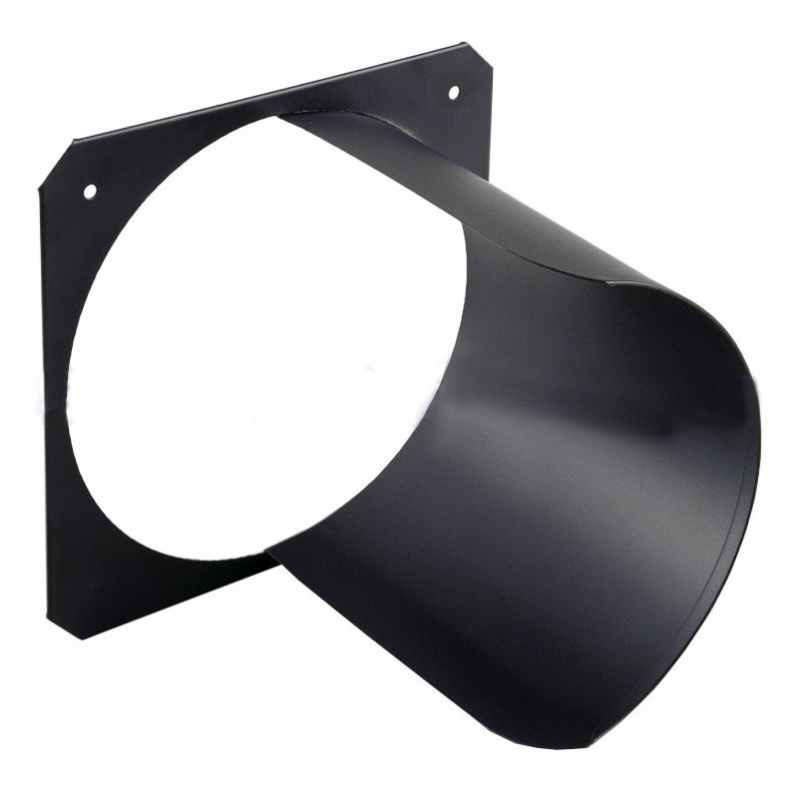
Iris and Hats/snoots
Iris
Hat

Slide 31
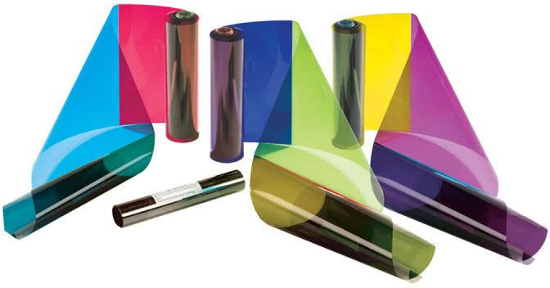
Doors and scrollers
Barn doors
Color scroller

Slide 32
Rotators and Mirrors (intelligent)
Gobo rotator
Moving mirror

