Slide 1
Introduction to Stage Lights
Module 1 – Lighting team and Theory

Slide 2
Why we light productions
To see the actors!
Create mood
Create atmosphere
To have control to change
Add an element of design

Slide 3
The manner in which light illuminates an object shapes the viewers impression and understanding of what they’re seeing

Slide 4
What can be controlled with lights
Angle
Intensity
Color
Sharpness
Effects/movement

Slide 5
Key terms
Distribution
Intensity
Movement
Color
Visibility
Focus
Modeling
Mood

Slide 6
Psychological perception of color
Warm and cool colors have an affect

Slide 7
The lighting production team
Lighting designer
Asst. Lighting designer
Programmer
Master Electrician
Electrician
Run crew (lighting area)

Slide 8
Lighting Designer
Responsible for developing lighting concept
Generates light plot and section drawings
Works with other design members for cohesion of design

Slide 9
Assistant Lighting Designer
Aids and assists the Lighting Designer
May be responsible for generating additional paperwork
May be the one present at hang/focus time
Assistant LD
2nd in command of lights
Assistant to LD
Lighting designer’s gofer
Associate LD
Reports to artistic director
Differences in titles

Slide 10
Programmer
Fluent with the operations of a lighting control board
Has clear communication with Lighting designer
Can interpret lighting paperwork
Programmers may run the show for one-off productions
Familiarity with lighting board and hung light plot

Slide 11
Master Electrician
Interprets lighting paperwork
Leads a lighting hang call
Troubleshoots electrical problems
Supervises electricians and run crew (lighting area)

Slide 12
Electrician
Works under the ME
Can read a light plot
Differentiates different lighting instruments
Able to hang, circuit, focus and address an instrument

Slide 13
Run crew (lighting area)
Usually in one of two areas
Board operator
Checks that all lights operate
Takes cues from SM
Follow spot operator
Manually manipulates a spotlight during a show
Takes cues from SM

Slide 14
Theory of electricity
Movement of electrons
Electrons flow from negative to positive
Coper wire has loose electron structure
Makes for efficient electron flow
Other good conductors
Aluminum, Gold, and Silver

Slide 15
A/C and D/C current
Alternating Current
House power
Flips + to – to + 60 time a second
Used for supplying power long distances
Invented by Nikola Tesla
Direct Current
Battery power
Consistent electron flow in one direction
Better suited for short distance power
Invented by Thomas Edison

Slide 16
Series versus parallel circuits
If one light were broken/removed the other lamps would continue to illuminate
If one lamp were broken/removed the whole circuit would be “open” and nothing would illuminate
When powered with the same voltage, a series circuit will only be a fraction of the voltage
This is due to additional resistance

Slide 17
”Open” or broken circuits
Things that intentionally break circuits
Switches
Circuit breakers
Fuses
Things that unintentionally break circuits
Cut/broken wires
Wires that have been pulled out from inside plugs
Blown lamps
Corroded contacts on lamp or base

Slide 18
Resistance
Resistance is the ability for electrons to flow
The higher the resistance, the more difficult it is for electrons to flow
Measured in Ohms
Represented by the symbol Ω
Ohm’s law
As voltage increases; current increases, as resistance increases; current decreases

Slide 19
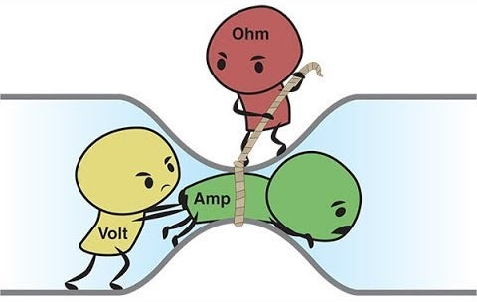
Ohm’s law mathematically expressed
I = E / R
“I” represents current in amps
“E” represents voltage in volts
“R” represents resistance in ohms
Can be rewritten
E = I R or R = E / I
Very useful when working with low voltage applications

Slide 20
The power “pie” formula
P = I E
“P” represents power in watts
“I” represents current in amps
“E” represents voltage in volts
Also remembered as West Virginia formula
W = V A
W = watts, V = volts, A = amps
Watt
The amount of energy converted or consumed
A unit of measurement for the power required to do the work

Slide 21
House versus business outlets
Standard home electrical outlets offer a maximum of 15 amps per circuit at 120volts
This can be checked by looking in your preacher panel
Business outlets by code are supposed to provide 20 amps at 120 volts

Slide 22
Solve for watts
How many total watts are available to you in a home (15 amp) circuit?
How many total watts are available to you in a business (20 amp) circuit?
Watts = Volts x Amps

Slide 23
American Wire Gauge Current Capacity Chart
Gauge of wire 10 12 14 16
Capacity in amps 25 20 15 6
Capacity in watts 3000 2400 1800 720

